Slide 1
Wellbeing and the liveable city
7 December 2012
Royal Society

Slide 2
Programme

Slide 3
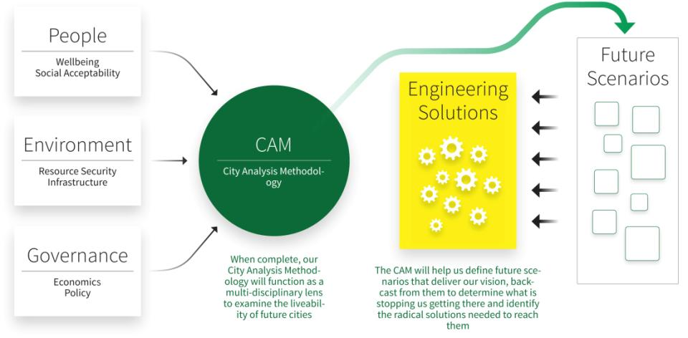
RC2: Wellbeing

Slide 4
Research Challenge 2
How do we ensure that radical engineering solutions take into account the human dimensions of living and working in a city?
How can our understanding of human and organisational aspirations and behaviour inform engineering solutions to deliver low carbon living?
How do we assess quality of life, wellbeing and citizen aspirations, and translate them into design criteria for transforming the engineering of cities?
Notes:
The research challenge is: to develop a rigorous means of social analysis of cities, that also generates engineering design criteria on quality of life and well-being within a low carbon strategy, and is tested through the design and implementation of the engineered solutions.

Slide 5
Research Challenge 2
How do we ensure that radical engineering solutions take into account the human dimensions of living and working in a city?
How can our understanding of human and organisational aspirations and behaviour inform engineering solutions to deliver low carbon living?
How do we assess quality of life, wellbeing and citizen aspirations, and translate them into design criteria for transforming the engineering of cities?

Slide 6
Wellbeing definitions, indicator sources & indicator categories

Slide 7
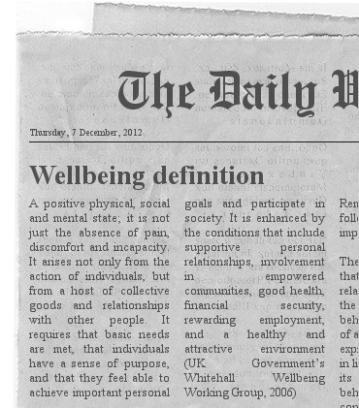
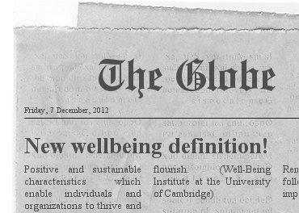
Wellbeing definitions

Slide 8
Wellbeing definitions
What is wellbeing?
A positive state of physical, mental and social being
Not just the absence of pain, discomfort or incapacity
A dynamic process
Requires basic needs to be met
Involves social connectedness, giving, being active, taking notice and continuing to learn
Enhanced by a variety of conditions, including a healthy and attractive environment

Slide 9
Indicator sources
Found over 2,300 indicators from 98 sources
Scale range | Count | Example
International | 20 | Eurobarometer
National (International) | 7 | Canadian Index of Wellbeing
National/local (International) | 1 | Quality of Life in New Zealand’s Cities
Subregional (International) | 1 | Illinois State Civic Index
Local (International) | 2 | City of Dresden Citizen Survey
National | 22 | Opinions and Lifestyle Survey
National/local | 2 | Measuring Progress/SDIYP
National/sublocal | 1 | Citizen Survey
Regional/local | 1 | North West Mental Wellbeing Survey
Local | 2 | Place Survey
Local/sublocal | 2 | Wellbeing and Resilience Measure
Sublocal | 37 | Life Satisfaction Index

Slide 10
Percentage of subjective (qualitative) & objective (quantitative) indicators

Slide 11
Target demographics for the indicators

Slide 12
Target demographics for the indicators (unspecified demographics removed)

Slide 13
Indicator categories

Slide 14
Indicator examples
Category | Example
Community participation | Do you feel a sense of community in your local neighbourhood?
Crime | How safe do you feel walking alone in this area after dark?
Environment | Percentage of wards in the 10% most deprived areas
Housing | How satisfied are you with your flat/accommodation?
Planning | Share of sustainably-classified buildings of all new and renovated buildings
Political participation | Participation rates in most recent election
Psychological health | Overall, how happy did you feel yesterday?
Social support | How often do you speak to your neighbours?

Slide 15
Indicator analysis & selection

Slide 16
Indicator analysis
Step 1
Does the category fit into another category?
Should the category be split into one or more categories?
Step 2
Does the category fit with the wellbeing, low-carbon and built environment factors?
Does the measure fit with the wellbeing, low-carbon and built environment factors?
Step 3
How many factors does the measure satisfy?
How strong is the relationship between the measures and the factors?
Can the measures be grouped together? If so, how many groups?
How easy would it be to obtain data/information for each measure?
Which measures will be used?

Slide 17
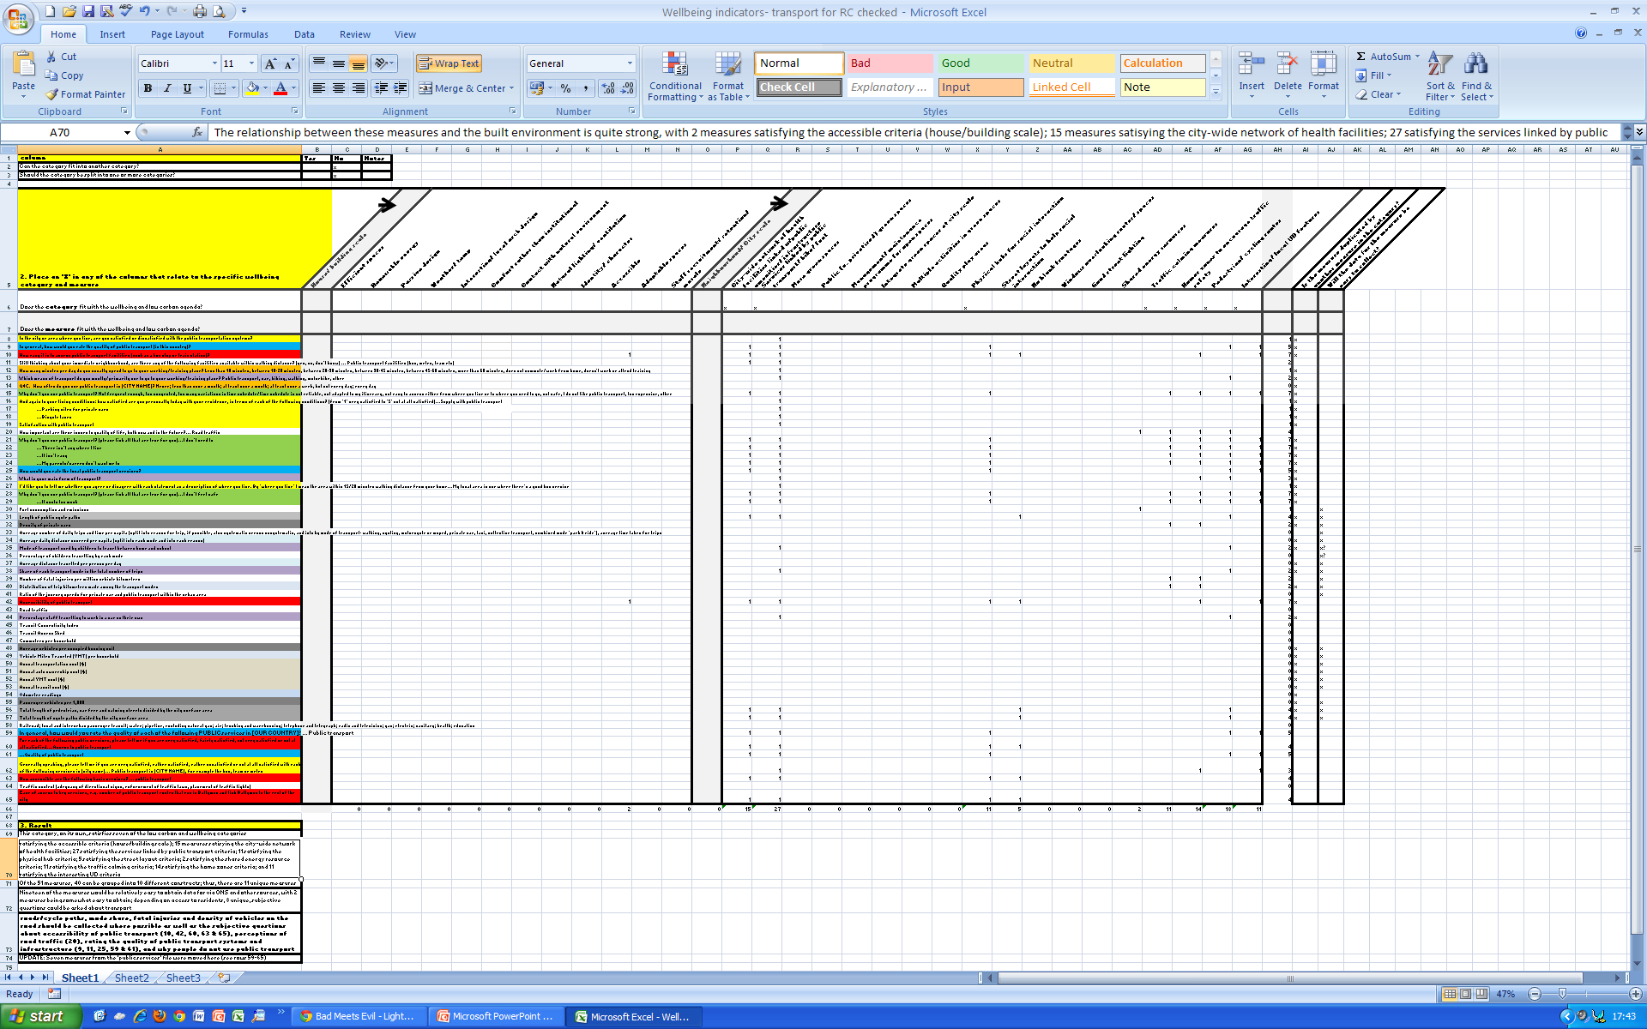

Slide 18
Indicators we wish to use
Category | Indicator
Community participation | Percentage of people who feel they belong to their neighbourhood How would you describe your sense of belonging to your neighbourhood? What sorts of things stop you from doing any activities you would like to do?
Crime | Personal crime rate Percentage of children who feel safe going to/from X How safe do you feel walking alone in this area after dark? How safe do you feel walking alone in this area during the day? How safe do you feel in [CITY NAME]? It is safe to be out and about on the streets

Slide 19
Indicators we wish to use
Category | Indicator
Environment | Average ecological footprint Populations living in areas with in relative terms, the least favourable environmental conditions Percentage of wards in the 10% most deprived areas Percentage of households satisfied with the quality of the places in which they live In your city or area where you live, are you satisfied or dissatisfied with the beauty or physical setting? It is important to me that I can be proud of my local environment Do you live within a ten-minute walk of a natural blue or green space? What do you think of the parks and play areas in your area? My local area is safe for children to play outside [CITY NAME] is committed to the fight against climate change

Slide 20
Indicators we wish to use
Category | Indicator
Housing | Housing quality Share of total population/households living in substandard/unfit housing Satisfaction of people over 65 with both home and neighbourhood How important is housing quality to quality of life, both now and in the future? My (family’s) home is nice I wish I lived in a different house
Planning | Share of sustainably-classified buildings of all new and renovated buildings Presence of an integrated plan in the city How important is more building in the countryside to quality of life, both now and in the future?

Slide 21
Indicators we wish to use
Category | Indicator
Political participation | Participation rates in most recent/local/national election Which of the following, if any, have you done during the last twelve months? (list several options) How much influence do you have over the quality and variety of local sporting facilities?

Slide 22
Gaps in the selected indicator set
Category | Gaps
Energy | Subjective indicators needed?
Food | Indicators needed about satisfaction with food suppliers, quality of food?
General life satisfaction | Indicators needed about life satisfaction/optimism/quality of life in the past/present/future? Indicators needed using a ‘ladder of participation’?
Governance | Indicator about percentage reporting that policies of X government have made them better off

Slide 23
Gaps in the selected indicator set
Category | Gaps
Information & knowledge | Indicators needed about the quality of information and knowledge sought? Indicators needed about what media people use to access information and knowledge?
Infrastructure | Are any indicators needed?
Political participation | Indicators as they relate only to wellbeing?
Private services | Additional private services needed?
Spirituality | Any indicators needed?

Slide 24
Questions
What would you need to do differently to create/achieve a low-carbon city?
If emphasis is on x, how will this impact on quality of life/wellbeing?
What measures should we be using to look at this?

