Slide 1
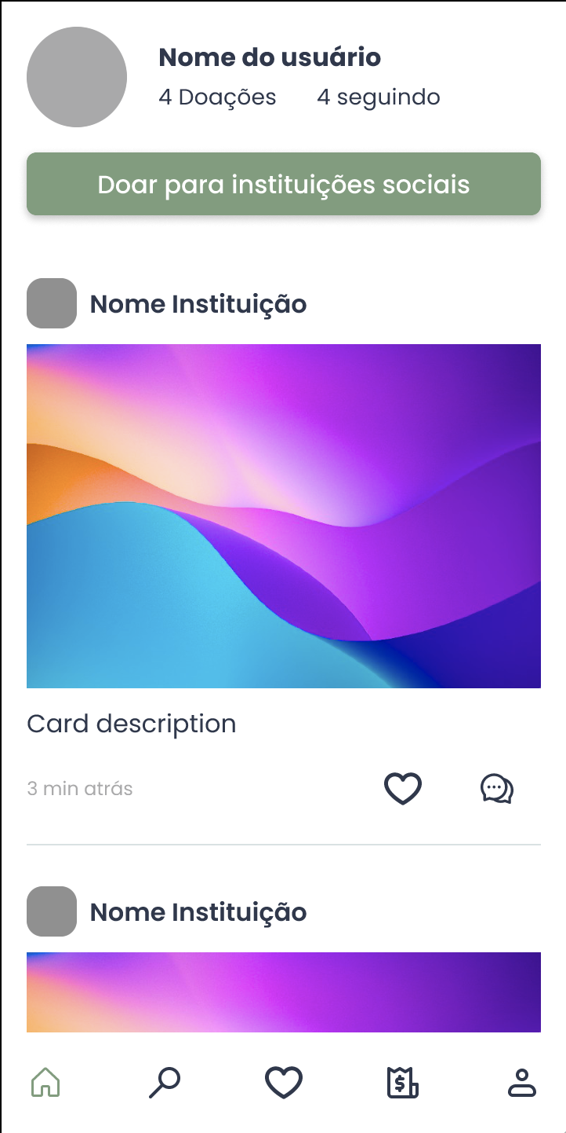
What is this for?
How do the posts are presented on the mobile screen?
This screen presents the news feed with posts, photos, and updates from charities that you follow
The “Donate to charities” takes you to the institution search page
The news feed shows the last posts from the institutions that you follow in chronological order.
User name
4 Donations 4 following
Donate to charities
Charity
If you could take advantage of this feature, what would you do? In a few words, tell us how you would exploit this feature to increase your potential for donation
Se você pudesse mudar qualquer informação desse protótipo para que sua instituição pudesse tirar vantagem da plataforma, o que você faria? Mostre onde e como você mudaria?
Charity

